Slide 1

Lakessa Johnson
PLC Coach

Slide 2

Black History Month
Oprah Winfery

Slide 3
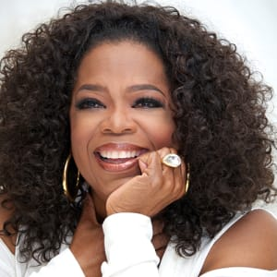
OPRAH
WINFERY

Slide 4

Billionaire media executive and philanthropist Oprah Winfrey is best known for hosting her own internationally popular talk show from 1986 to 2011. From there she launched her own television network, OWN.

Slide 5

Oprah Winfrey is a talk show host, media executive, actress and billionaire philanthropist. She’s best known for being the host of her own, wildly popular program, The Oprah Winfrey Show, which aired for 25 seasons, from 1986 to 2011. In 2011, Winfrey launched her own TV network, the Oprah Winfrey Network (OWN).

Slide 6
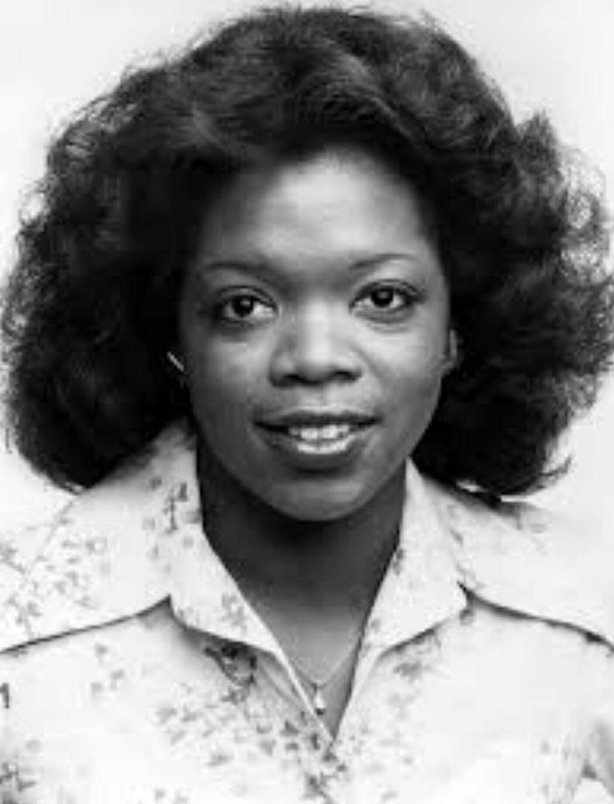
Oprah Winfrey was born in the rural town in Mississippi, on January 29, 1954 in a small community. In 1971, Winfrey entered Tennessee State University. She began working in radio and television broadcasting in Nashville.

Slide 7
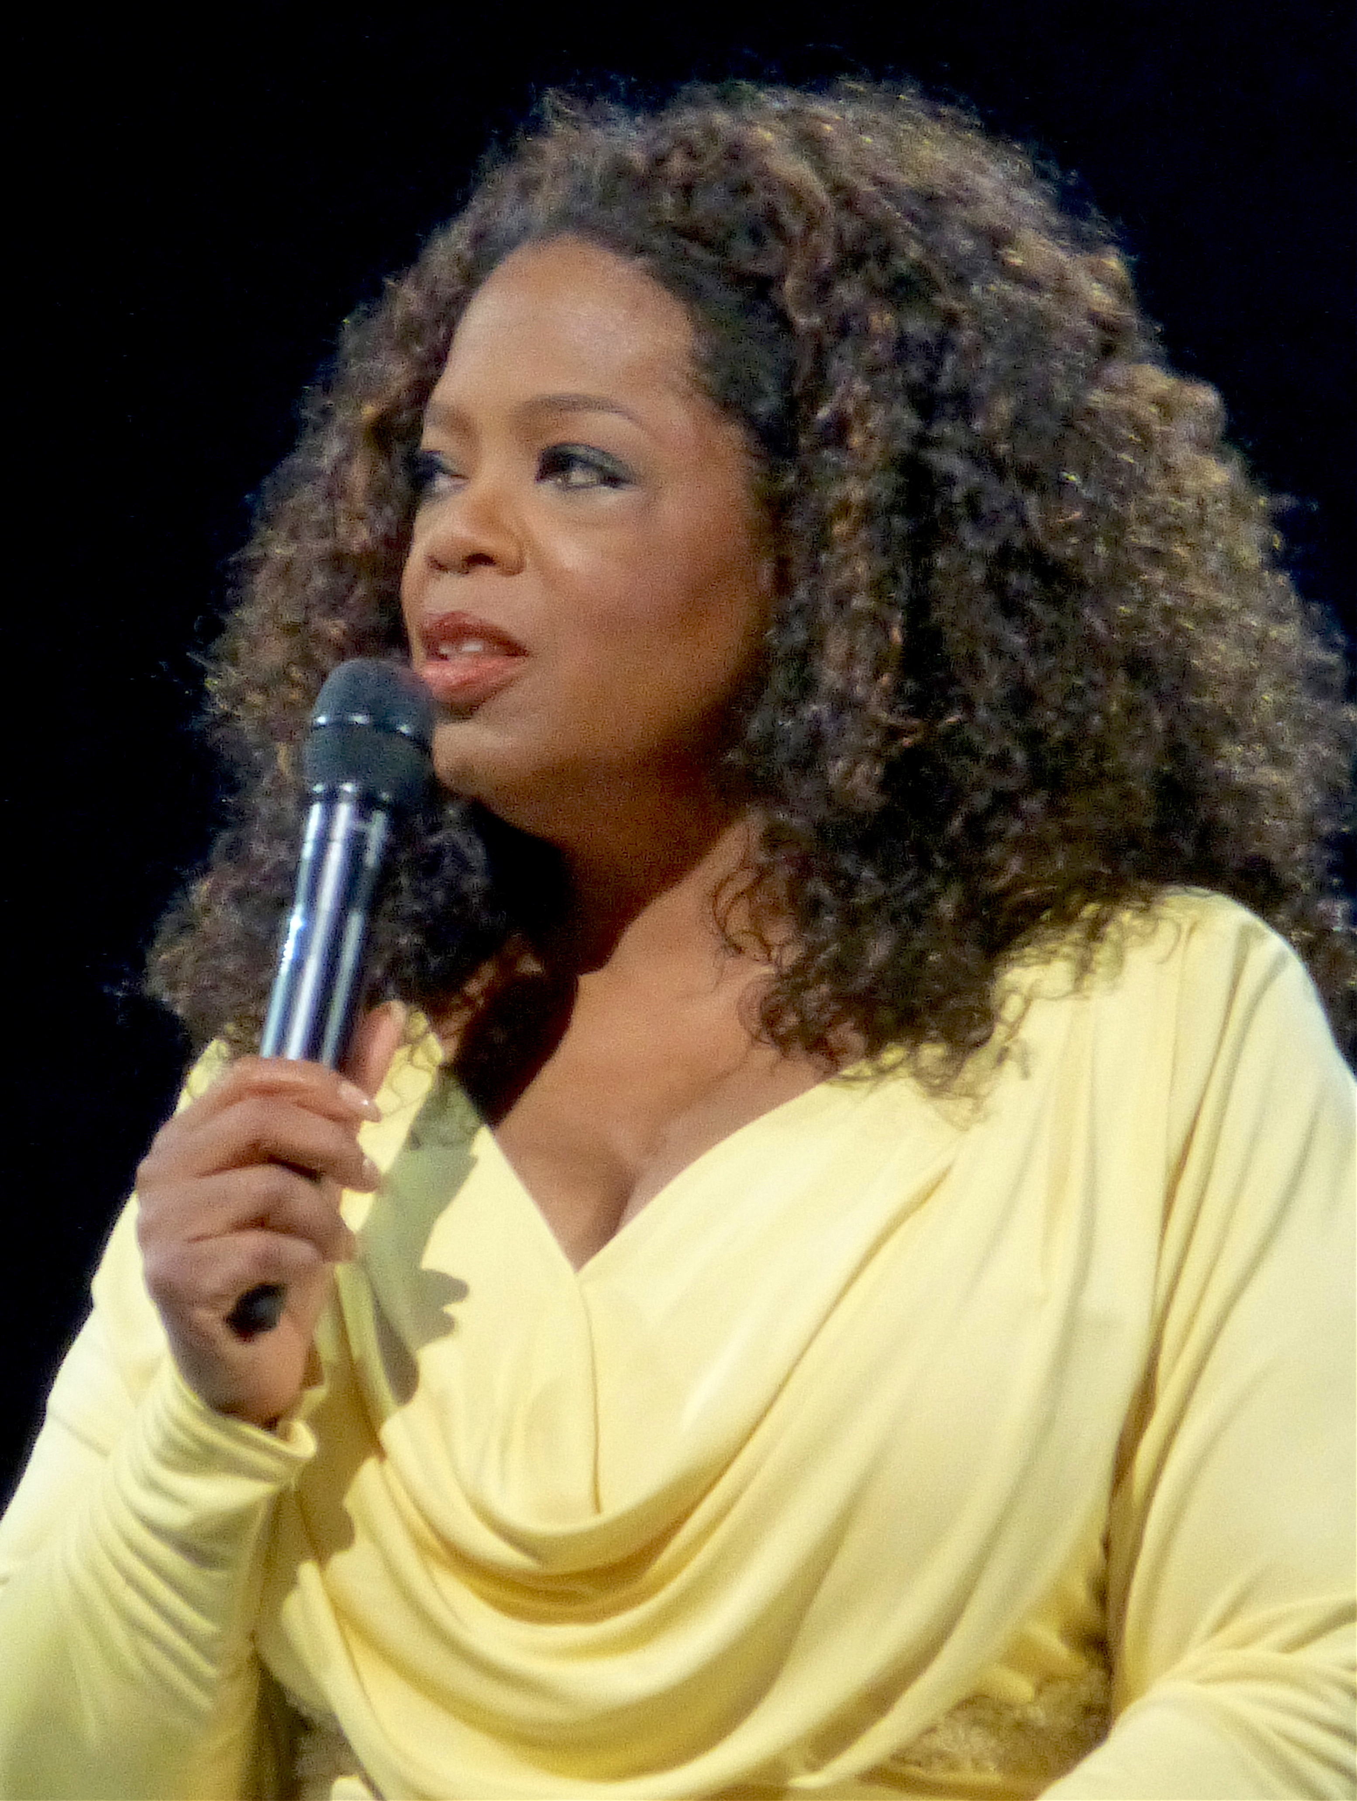
Winfrey launched The Oprah Winfrey Show in 1986 as a nationally syndicated program that ran for 25 years, until 2011. With its placement on 120 channels and an audience of 10 million people, the show grossed $125 million by the end of its first year, of which Winfrey received $30 million.

Slide 8


In 1999 Winfrey debuted Oxygen Media, a company she co-founded that’s dedicated to producing cable and Internet programming for women. In doing so, Winfrey ensured her spot in the forefront of the media industry as one of the most powerful and wealthy people in show business.
Winfrey’s highly successful monthly magazine, published by Hearst, O: The Oprah Magazine, debuted in 2000.

Slide 9
